Slide 1

Median filter
3 datasets
Two-level Otsu thresholding
Gaussian filter
Otsu thresholding
Histogram stretching
Preprocessing
Postprocessing
Local adaptive thresholding average
Two-level Otsu thresholding clip
Dice Score
Optimal segmented image

Slide 2


Timeline recap
First steps
Final presentation
Local threshold
Otsu and Dice
10.05.
31.05.
14.06.
Buffer and report
28.06.
21.06.
17.05.
07.06.
Cell counting
Multithresholding
Project proposal
Preprocessing and testing

Slide 3
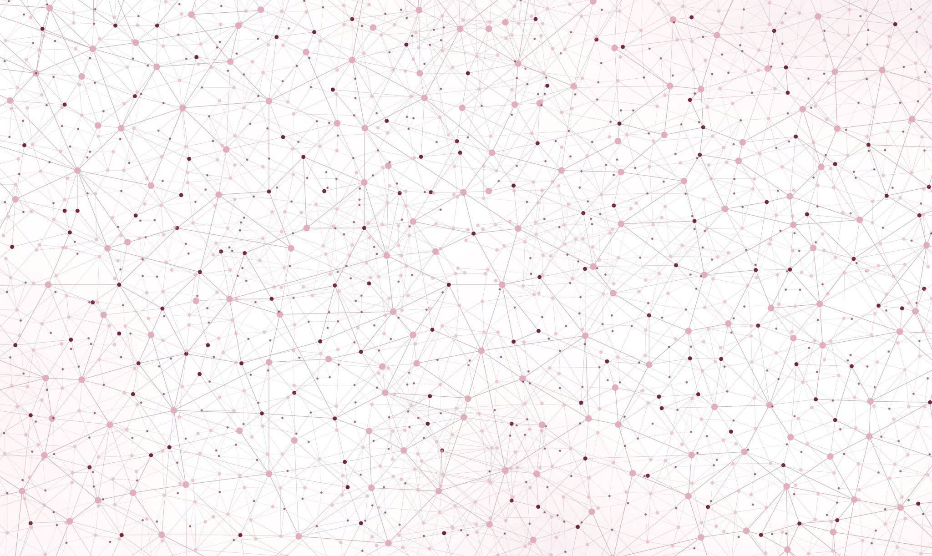
Cell Nuclei Segmentation
Implementation and Evaluation
of Otsu Thresholding
Final presentation
Topic 01: Biomedical Image Analysis
Supervisor: PD Dr. Karl Rohr, Christian Ritter, Tutor: Marie Becker
Group 01.04: Marie-Claire Indilewitsch, Helen Jade, Maribel Schneider, Ieva Sorokina-Ozola
Date: 20.07.2022

Slide 4
Overview
Challenges
Summary- our perfect recipe
Results and discussion
Recap datasets difficulties

Slide 5
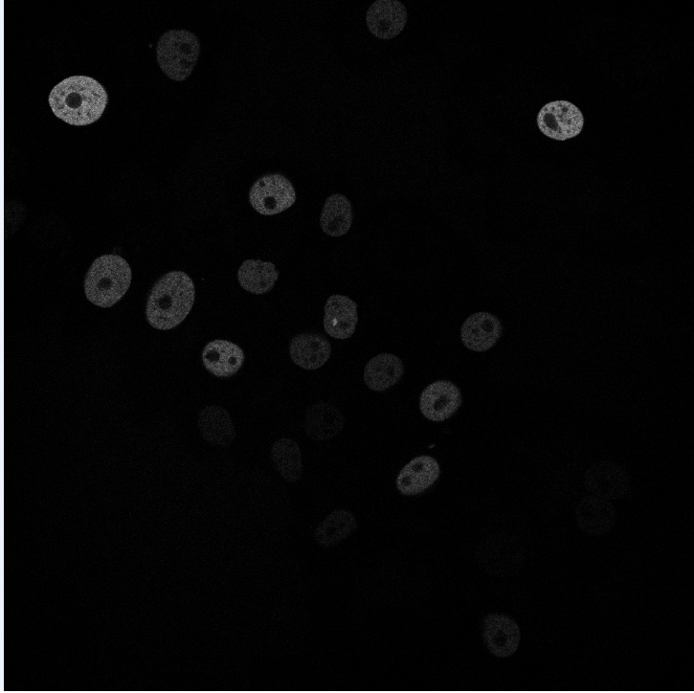
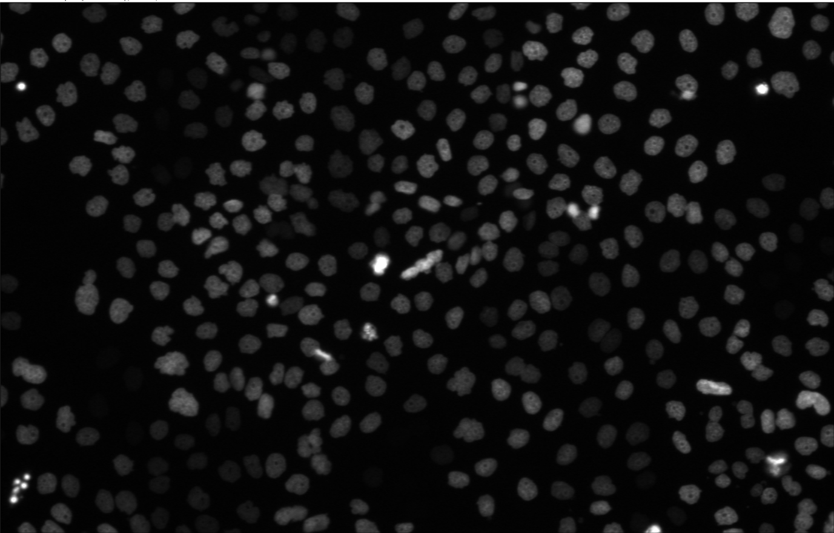
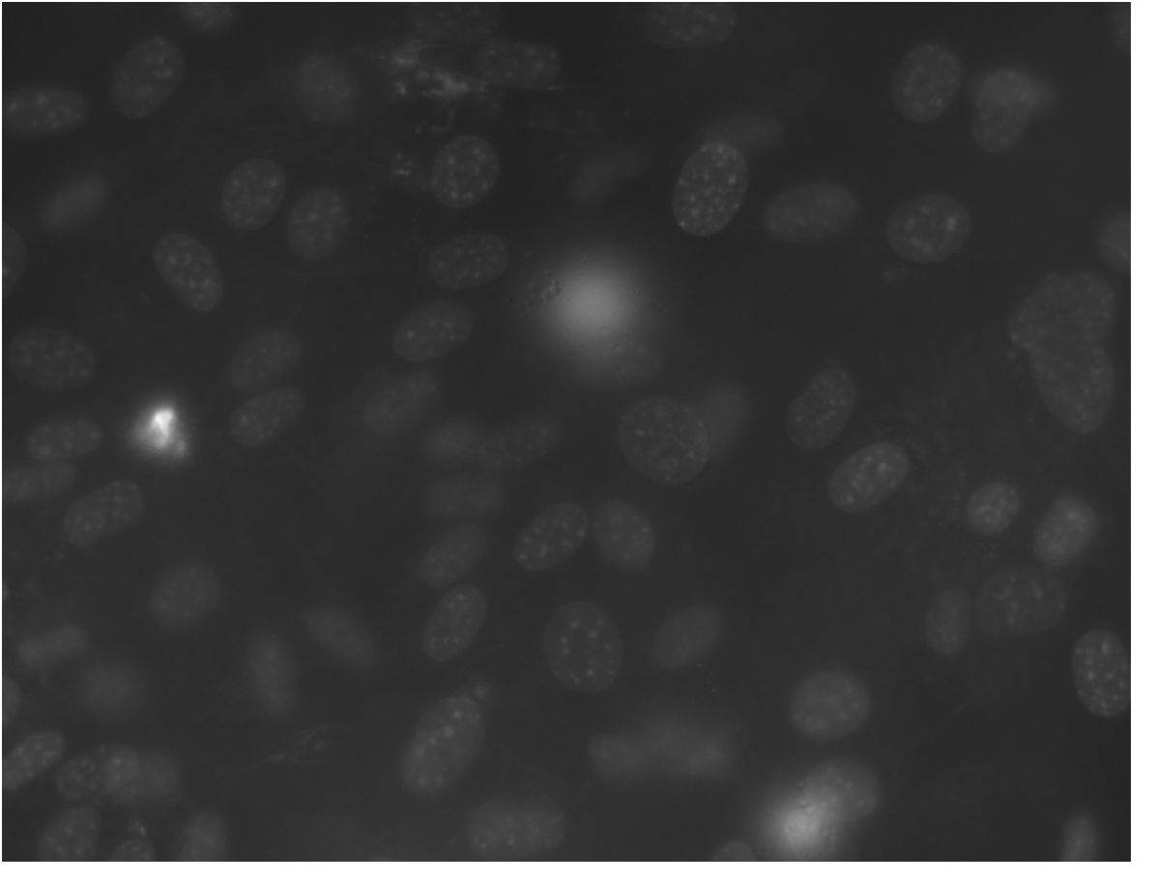


N2DL-HeLa (second dataset)
N2DH-GOWT1 (first dataset)
NIH3T3
(third dataset)
Noise
Low contrast
Holes
Varying brightness of cell nuclei
Low contrast
Non-uniform background
Reflections
L: low resolution
N: nuclear
H: high resolution
2D: two-dimensional

Slide 6
Our Expectations
 | Challenge | Preprocessing method | Otsu thresholding variation
N2DH-GOWT1 | Noise Low contrast Holes | Filters Histogram stretching and combinations +postprocessing | Global Otsu Two-level Otsu
N2DL-HeLa | Varying brigtness of cell nuclei Low contrast | Filters Histogram stretching and combinations | Global Otsu Two-level Otsu Local adaptive thresholding
NIH3T3 | Non-uniform background Reflection | Filters Histogram stretching and combinations | Global Otsu Two-level Otsu Local adaptive thresholding
Does the combination between preprocessing method and Otsu thresholding variation solve/improve the challenge?

Slide 7
Global Otsu thresholding

Slide 8
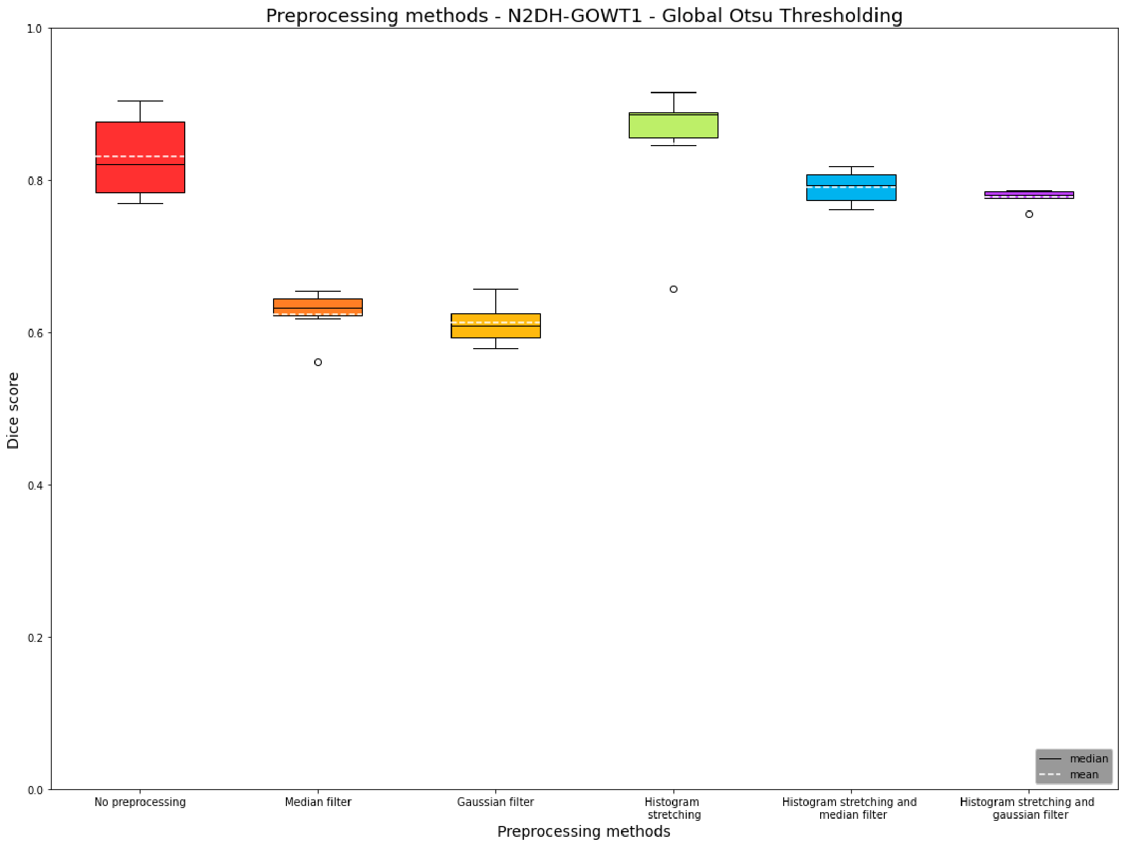
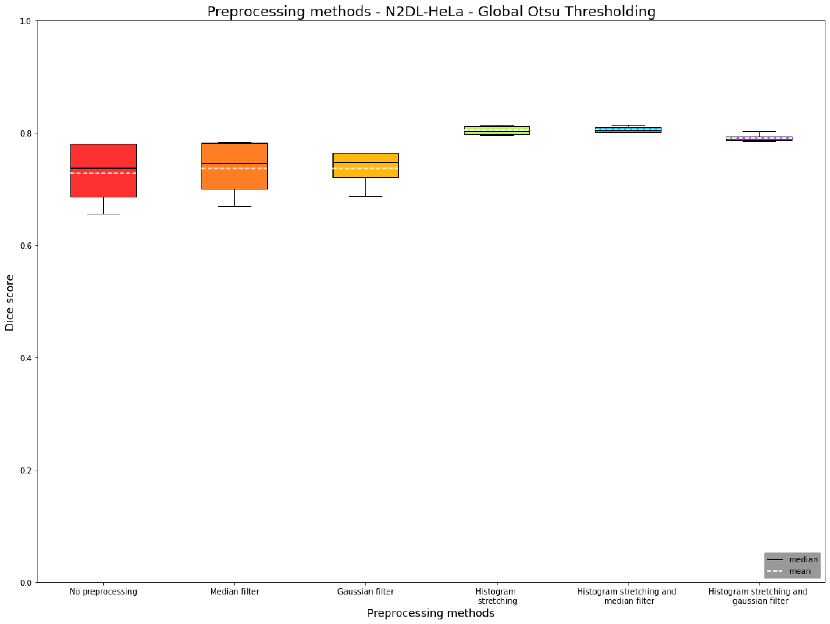
Preprocessing methods N2DH-GOWT1 and N2DL-HeLa

Slide 9
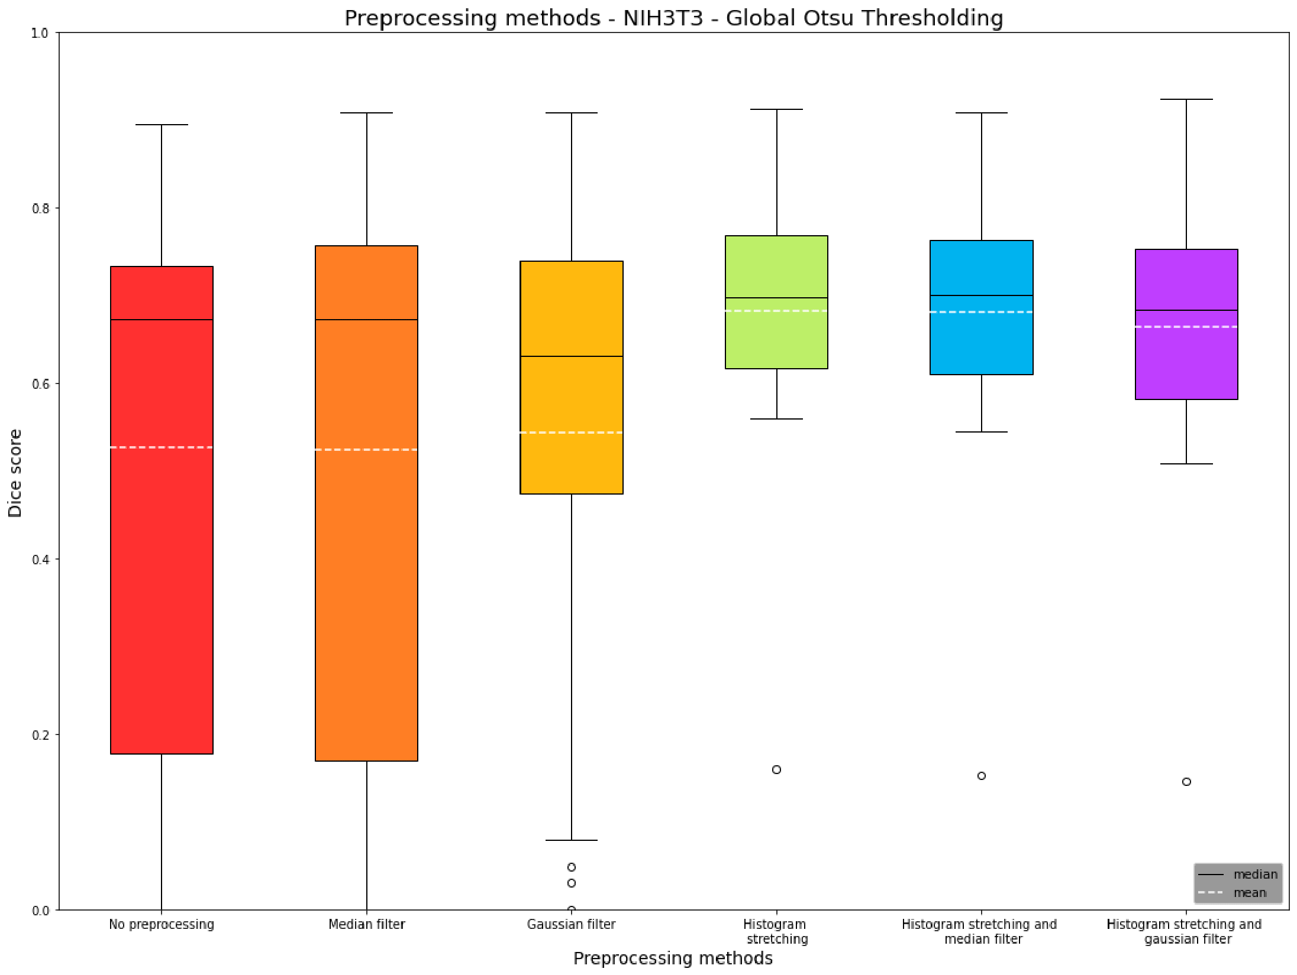
Preprocessing methods NIH3T3

Slide 10
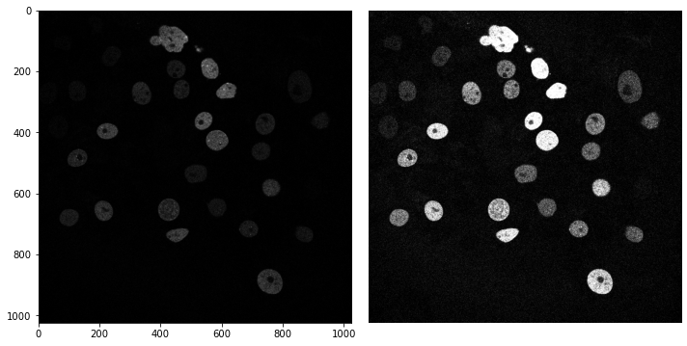
N2DH-GOWT1: Effects of histogram stretching

Slide 11
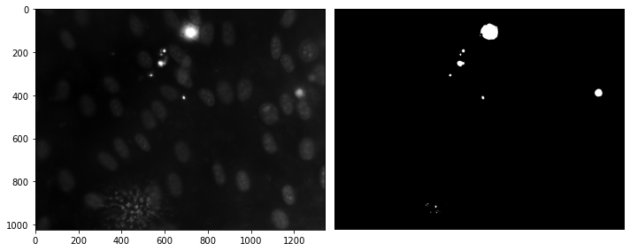
NIH3T3: Reflections

Slide 12
Two-level Otsu thresholding

Slide 13
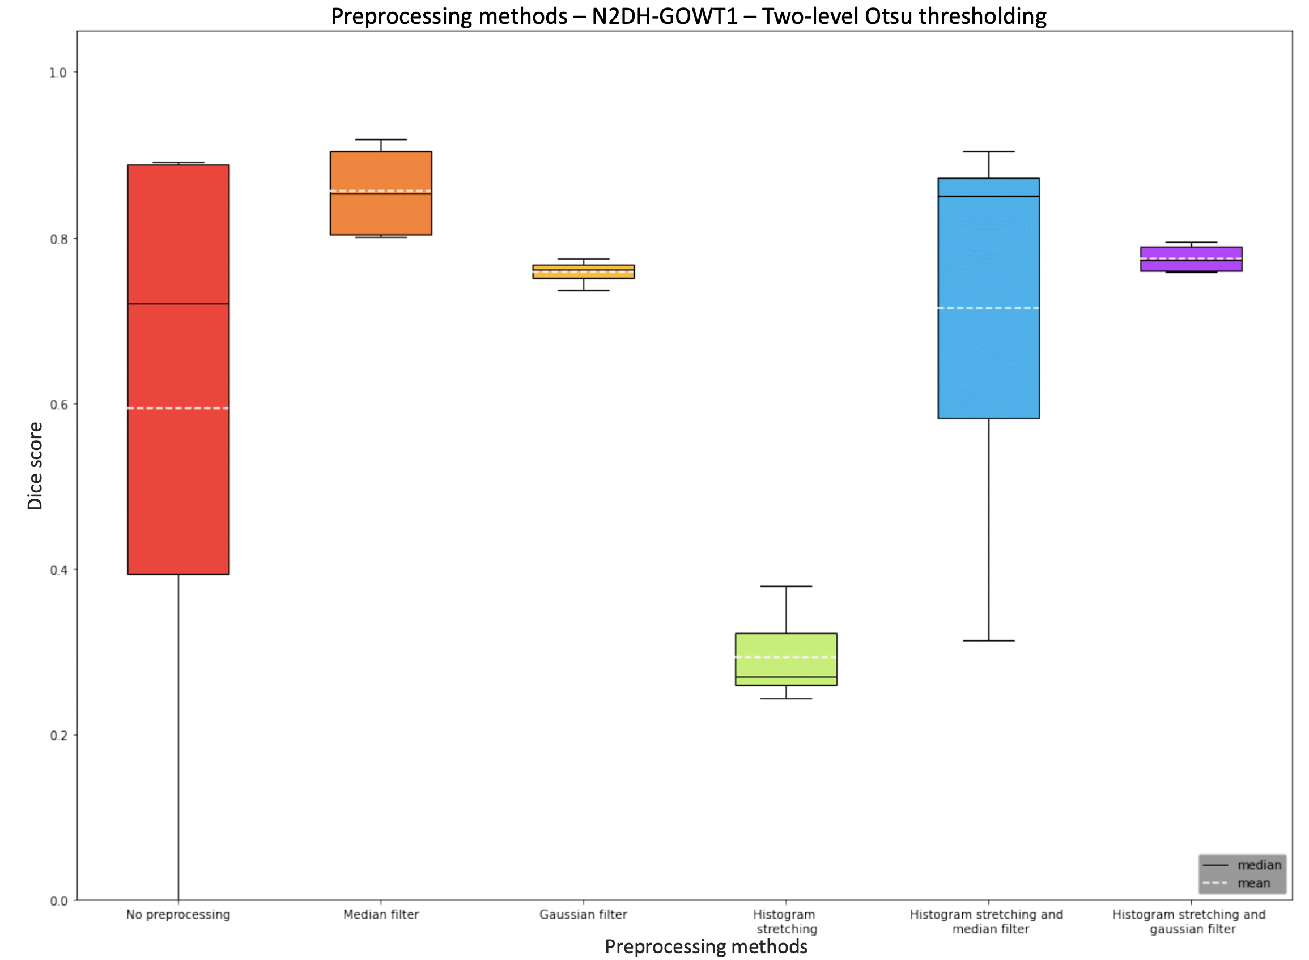
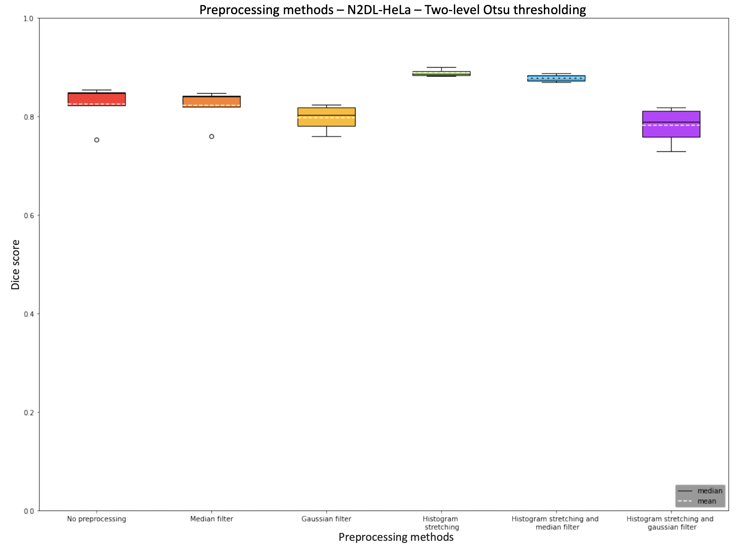
Preprocessing methods N2DH-GOWT1 and N2DL-HeLa

Slide 14
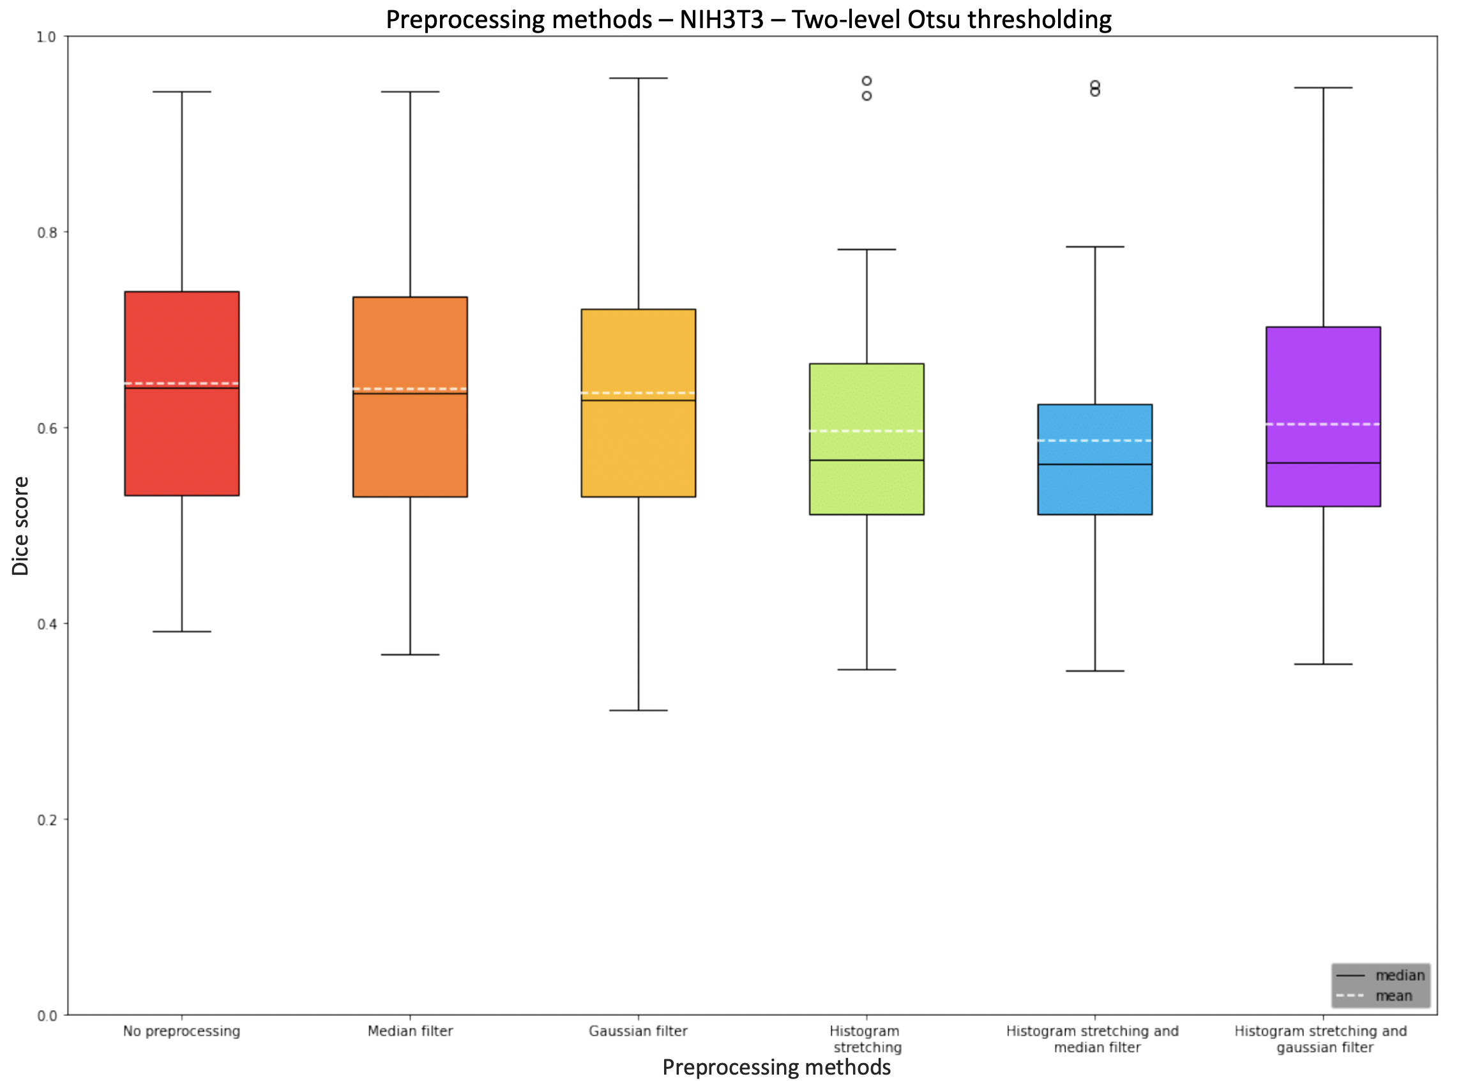
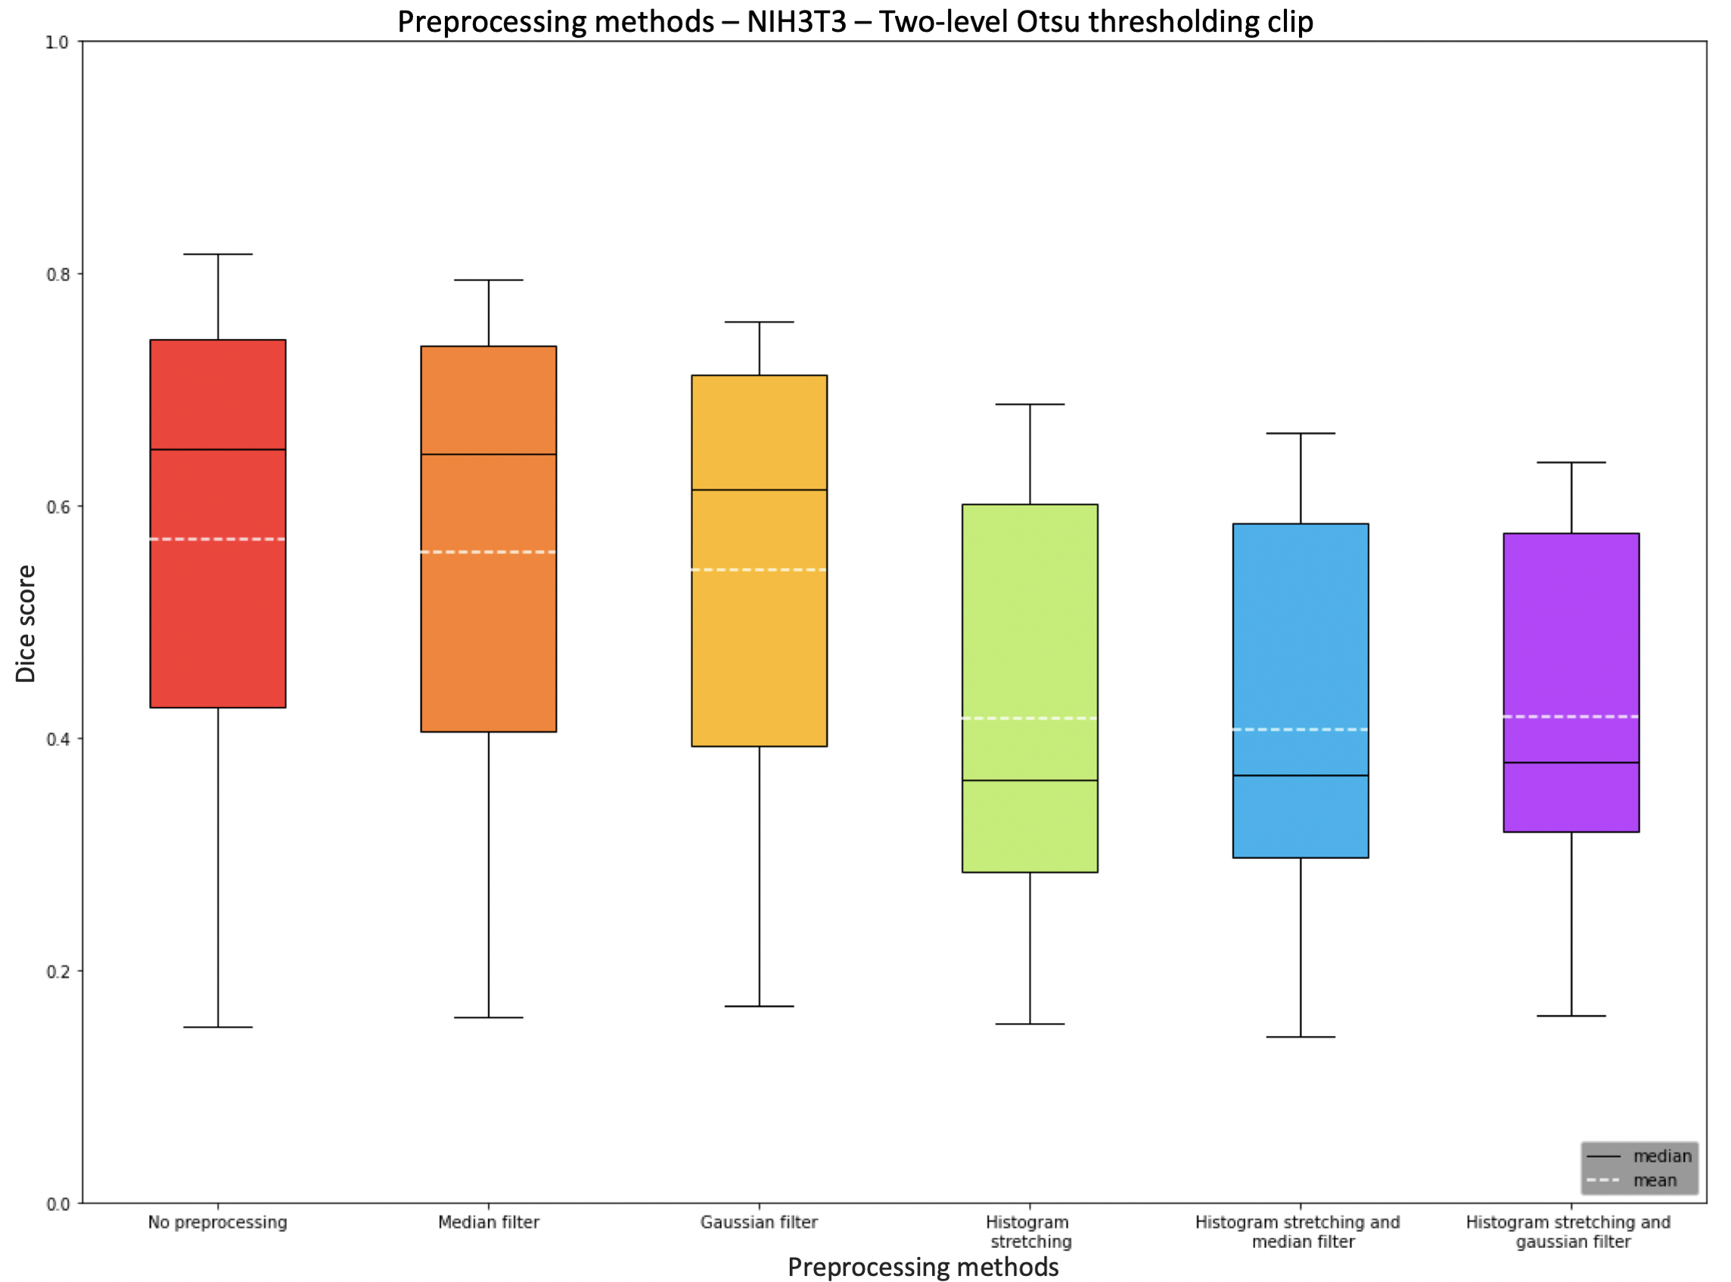
Preprocessing methods NIH3T3 two-level Otsu and clip

Slide 15
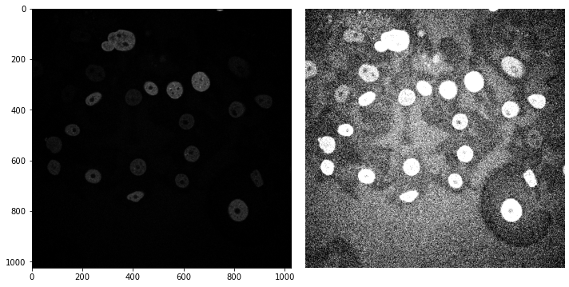
N2DH-GOWT1: Effects of histogram stretching

Slide 16
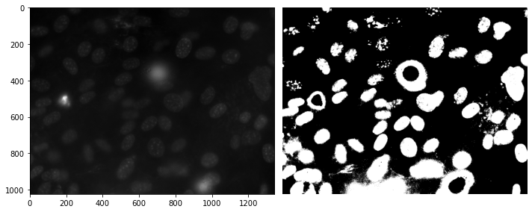
NIH3T3: Two-level Otsu thresholding clip

Slide 17
Local adaptive thresholding

Slide 18
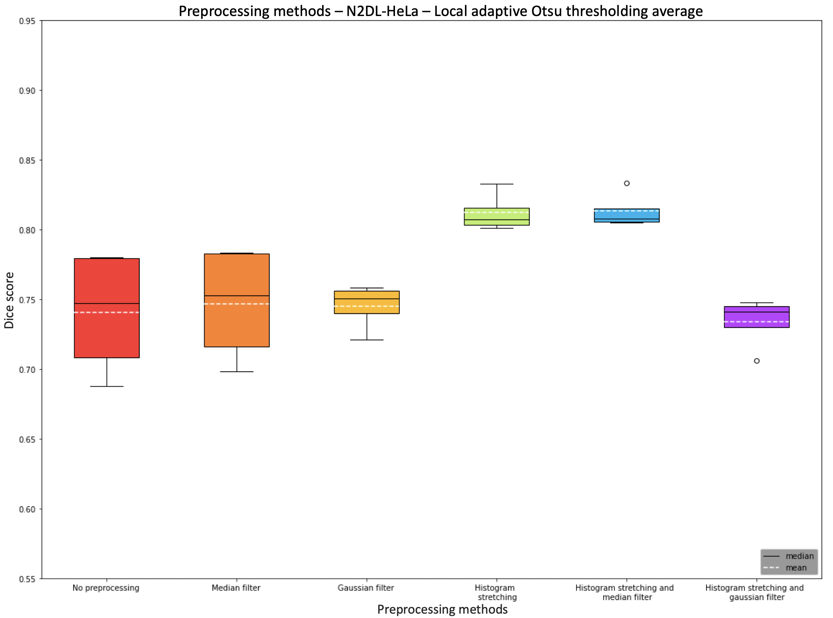
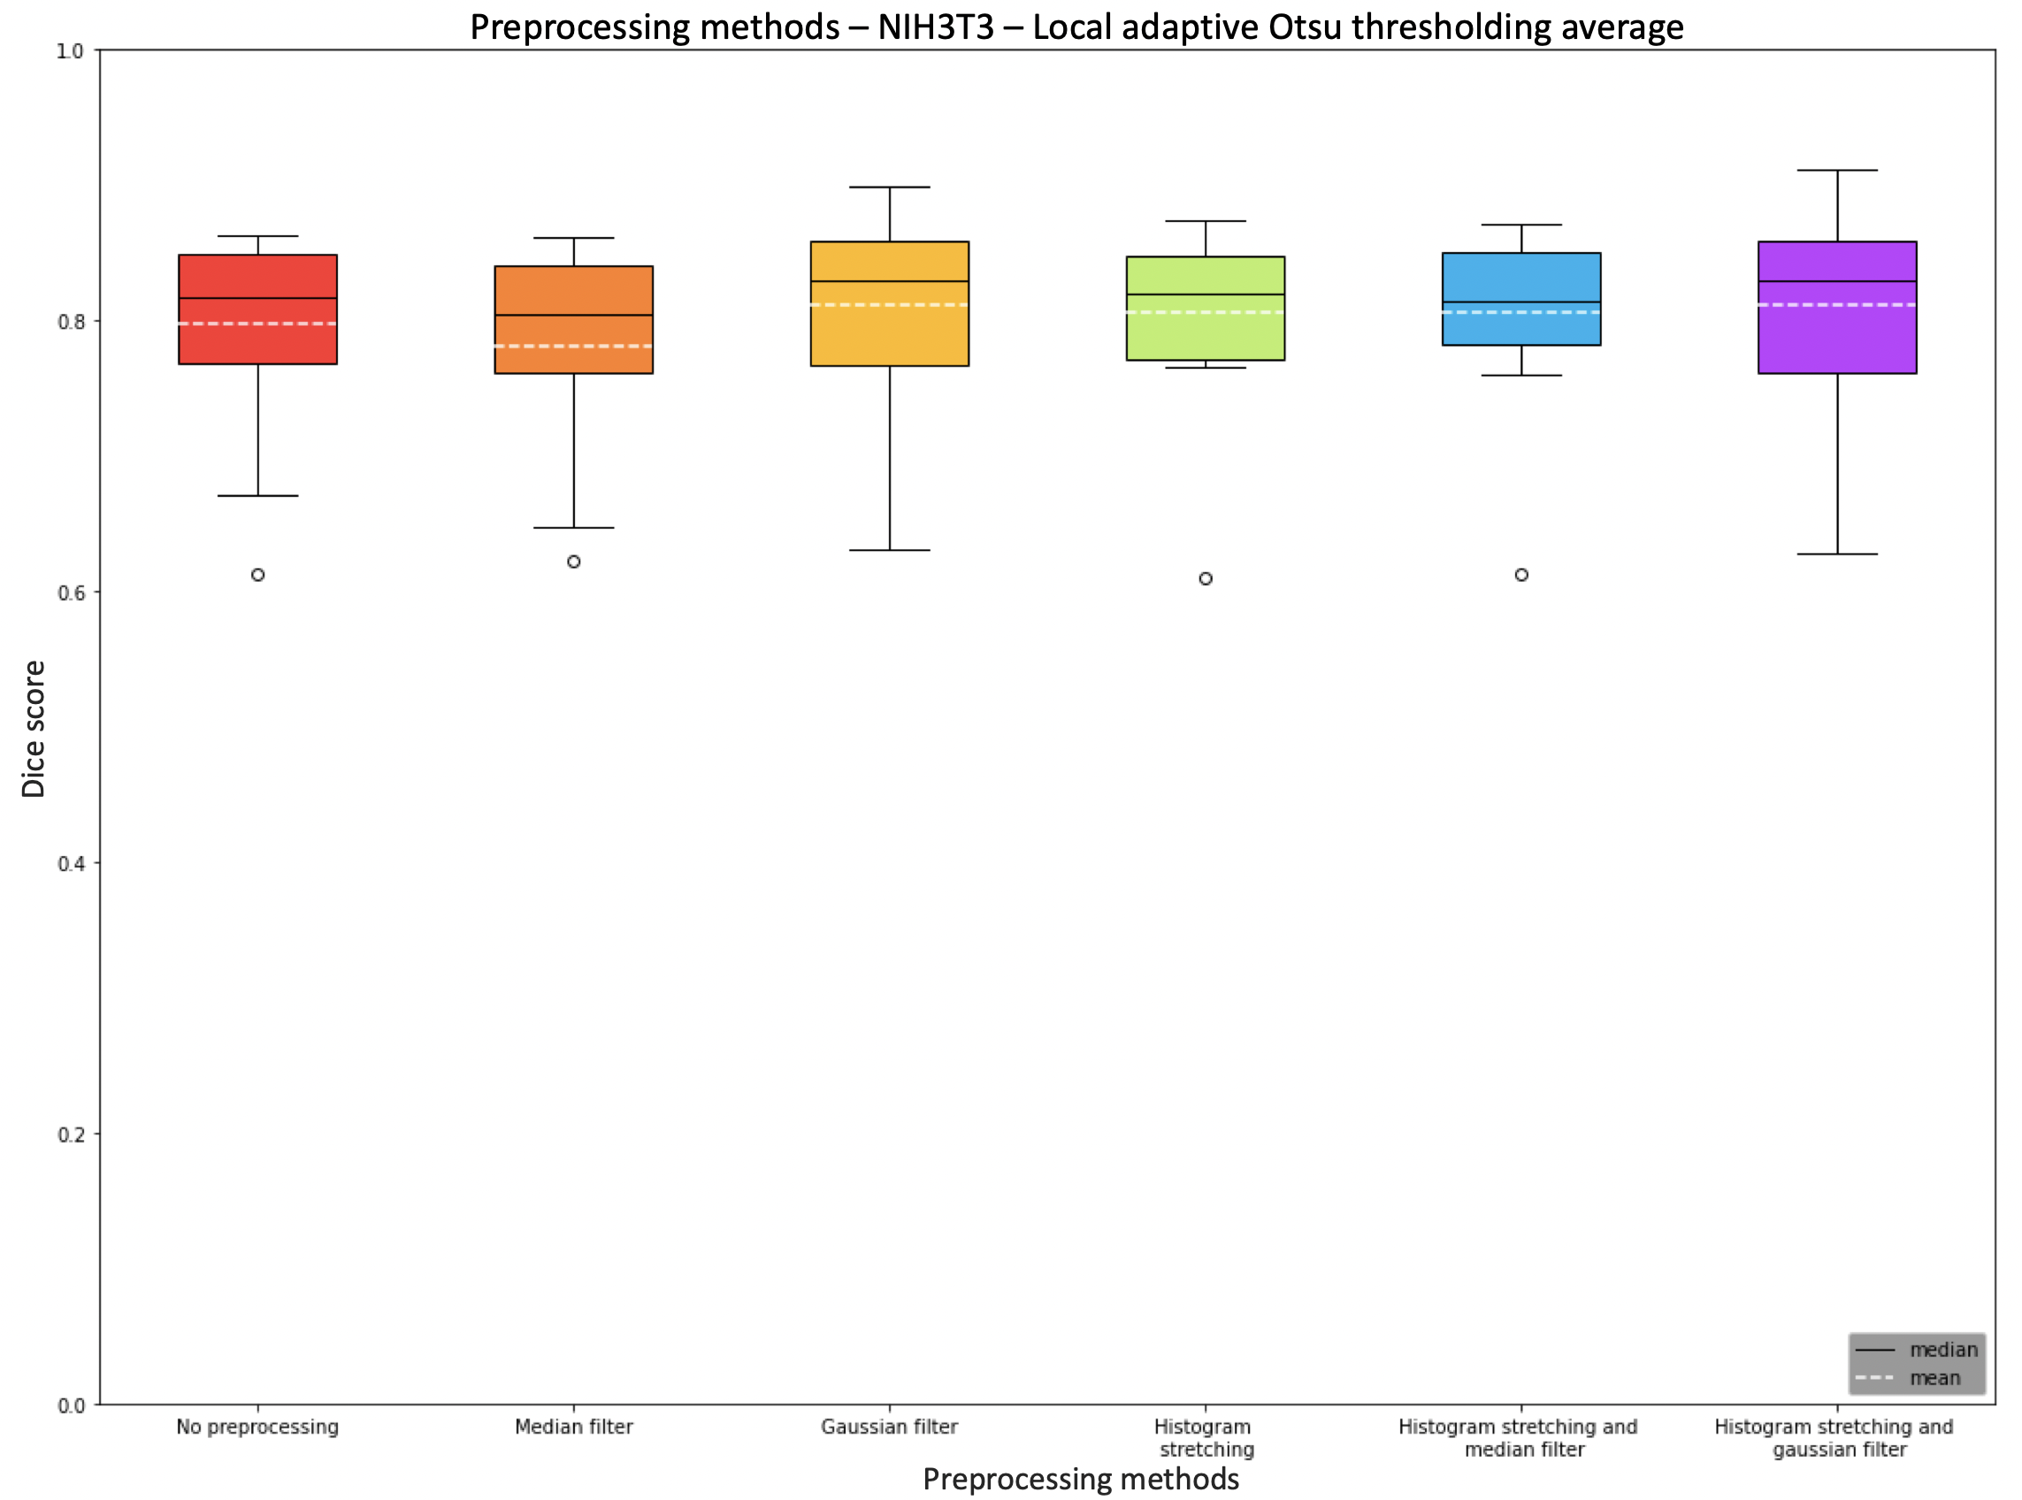
Preprocessing methods N2DL-HeLa and NIH3T3

Slide 19
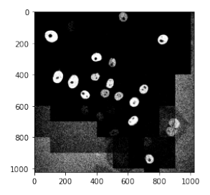
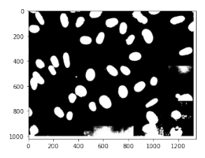
Challenges
Random noise
Unsegmented edges

Slide 20
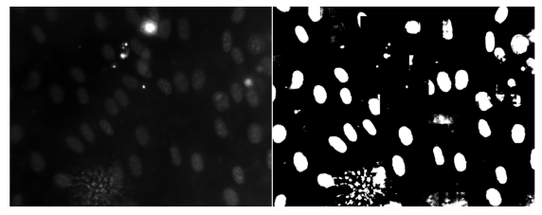
NIH3T3: Effects of local adaptive thresholding

Slide 21
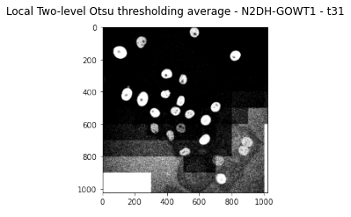
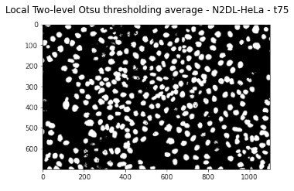
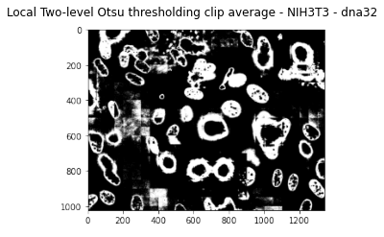
Local adaptive two-level Otsu thresholding

Slide 22
Challenges

Slide 23
Challenges
Runtime
Optimal bin size
Optimal filter size
Edge issue
Local adaptive Otsu thresholding count vs. Average

Slide 24
All challenges solved?

Slide 25
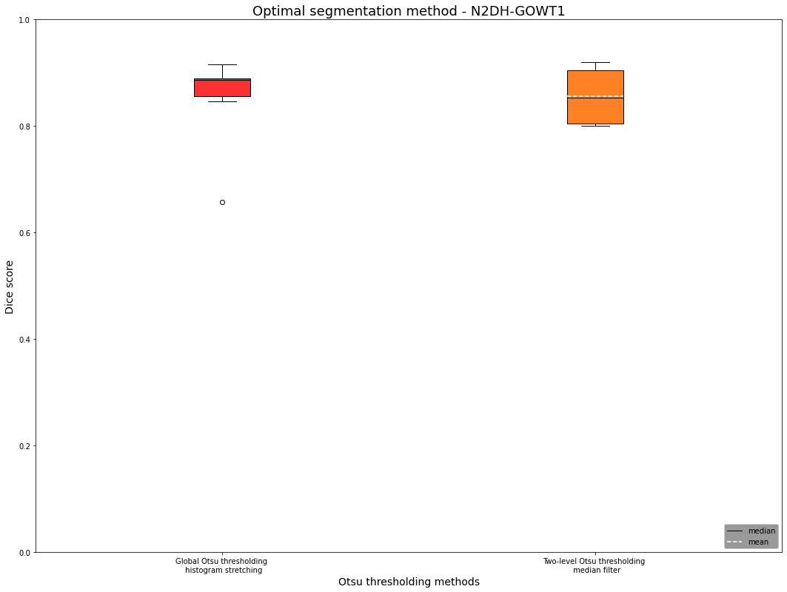
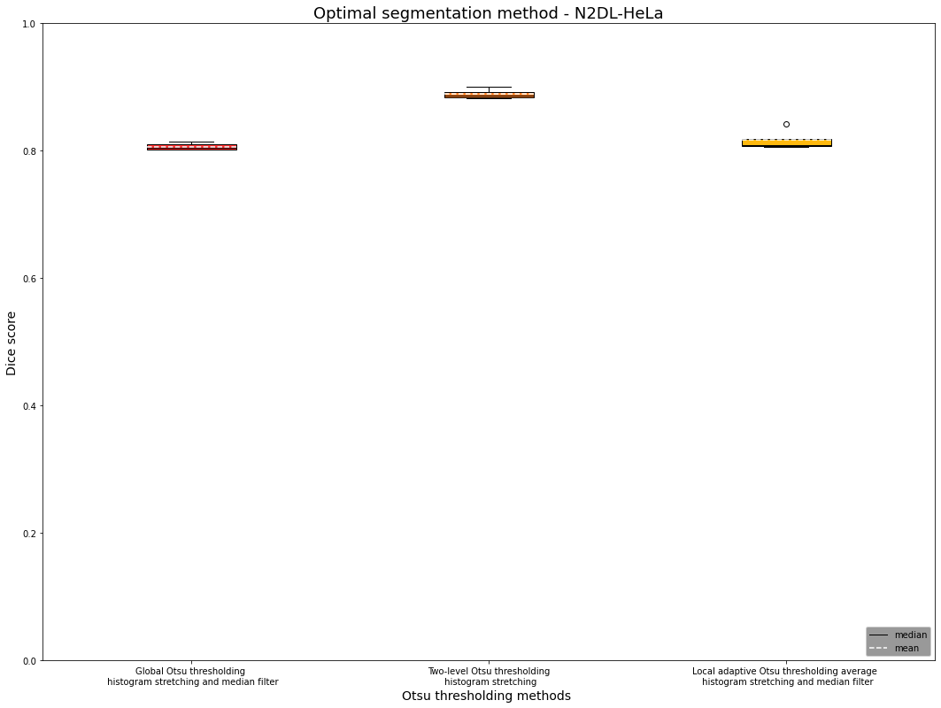
Optimal segmentation method for N2DH-GOWT1 and N2DL-HeLa

Slide 26
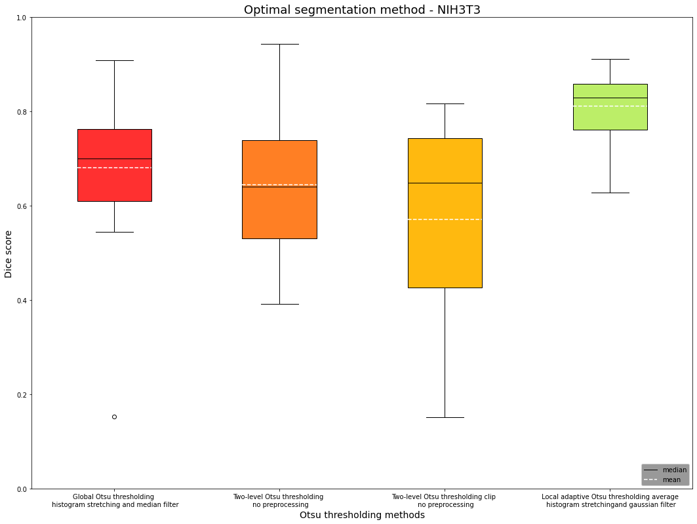
Optimal segmentation method NIH3T3

Slide 27
 |  | Global Otsu Thresholding | Two-level Otsu thresholding | Two Level Otsu Clip | Local adaptive thresholding average
N2DH-GOWT1 | Preprocessing method | Histogram stretching | Median filter
 | Dice Score | 0.89 | 0.85
NIH3T3 | Preprocessing method | Histogram stretching and median | No preprocessing | No Preprocessing | Gaussian filter and histogram stretching
 | Dice Score | 0.70 | 0.64 | 0.65 | 0.83
N2DL-HeLa | Preprocessing method | Histogram stretching and median | Histogram stretching |  | Median filter and histogram stretching
 | Dice Score | 0.80 | 0.89 |  | 0.81

Slide 28
Conclusion

Slide 29
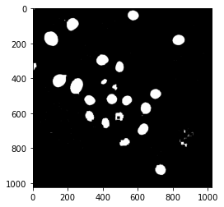
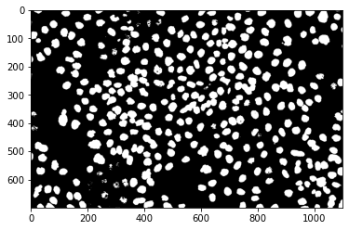
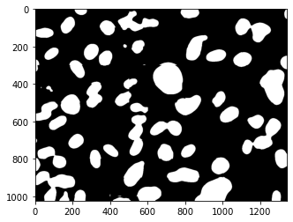
N2DL-HeLa (second dataset)
The perfect recipe
N2DH-GOWT1 (first dataset)
NIH3T3
(third dataset)
Preprocessing: histogram stretching
Postprocessing: hole filling
Otsu: global Otsu thresholding
Final median Dice Score: 0,8864
Preprocessing: histogram stretching
Otsu: two-level Otsu thresholding
Final median Dice Score: 0,8866
Preprocessing: Gaussian filter + histogram stretching
Otsu: local adaptive Otsu thresholding
Final median Dice Score: 0,8293
L: low resolution
N: nuclear
H: high resolution
2D: two-dimensional

Slide 30
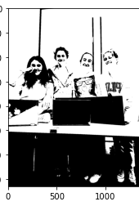
Thank you for your attention!

Slide 31

Extra slides

Slide 32
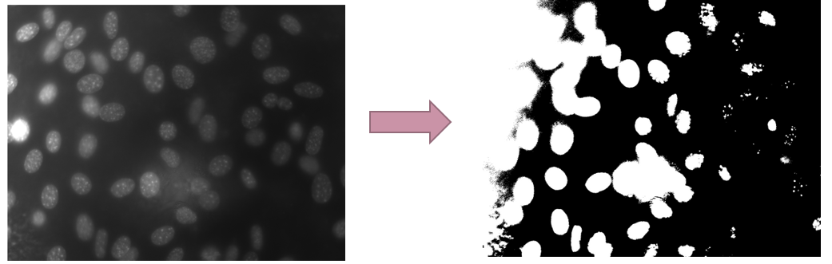
Why local thresholding?

Slide 33
Local thresholding vs local adaptive thresholing

Slide 34
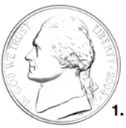
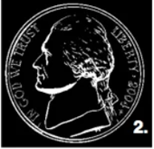
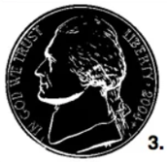
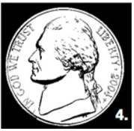
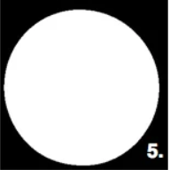
Hole filling

Slide 35
Cell counting
ideas:
Edge detection
clustering

Slide 36
Difference filter first or stretching first

Slide 37
Solution Ideas
Challenge | Solution
Random noise | Gaussian filter, median filter
Holes | Median filter
Low contrast | Histogram stretching
Reflections | Intensity clipping, multithresholding
Brightness | Local thresholding

Slide 38
Challenges: N2DL-HeLa
Reflections

Slide 39
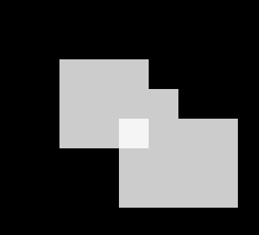


Dice score - Issues

Slide 40
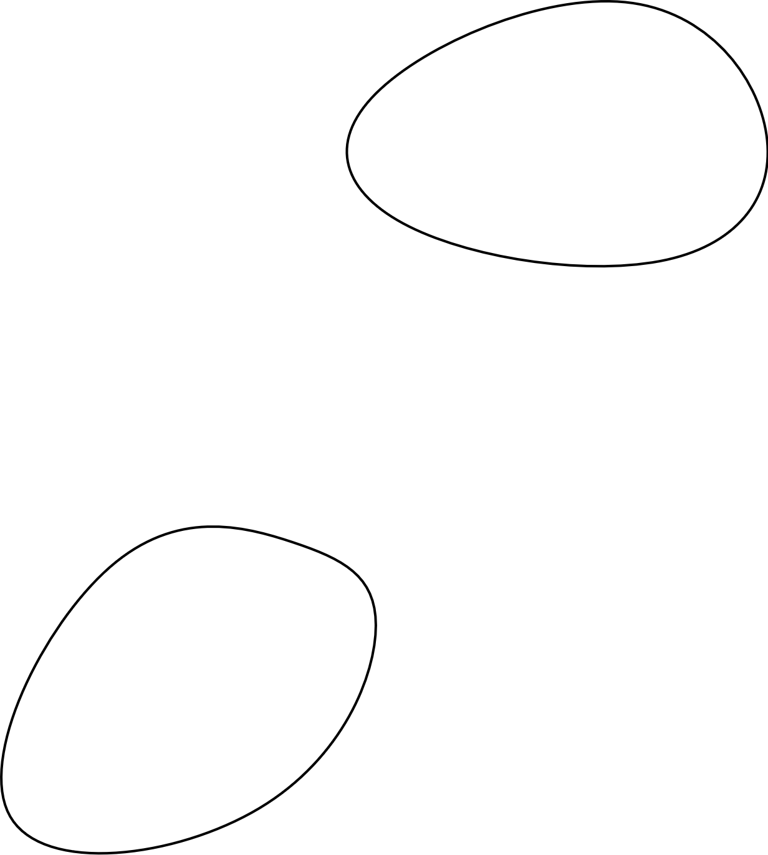
Evaluation algorithm – Dice score
~ 80% Accuracy

Slide 41

N2DH-GOWT1 Cell type: embryonic stem cells | Organism: Mouse (Mus musculus)
Express Oct4-GFP
Leica TGS SP5 (confocal microscope)
6 images total
1024x1024 pixels
10-20 nulei per image

Slide 42
NIH3T3 Cell type: Embryonic fibroblast cells | Organism: Mouse (Mus musculus)
Stained with Hoechst (fluorescent dye)
Fluorescence microscope
18 images total
Size: 1344x1024 pixels
about 60 nuclei per image

Slide 43

N2DL-HeLa Cell type: cervical adenocarcinoma cells | organism: human (Homo sapiens)
Express H2B-GFP
Olympus IX81 Confocal Microscope
4 images total
Size: 1100x 700 pixels
30-50 nuclei per image

Slide 44
Otus Thresholding usage
Locate cell boundaries
Cell type classification
Cell counting
Cell phenotype analysis (size, shape,..)
But not used for very complex images !

Slide 45
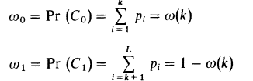
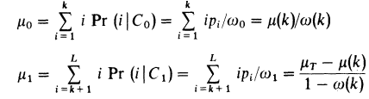
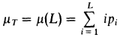
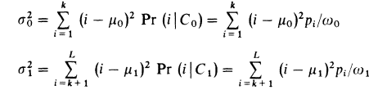
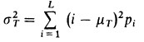
Otsu Thresholding
Class probabilities ($ω_{0,1}$):
Class mean levels ($μ_{0,1}$) and total mean level ($μ_{T}$):
Class variances ($σ_{0,1}^{2}$) and total variance ($σ_{T}^{2}$):
$L=$ Number of gray levels in the picture
$n_{i}=$ Number of pixels at level i
$N=$ Total number of pixels
$p_{i}=$ Probability of level i
$k=$ Threshold intensity
$$p_{i}= n_{i}/N$$
Otsu, N. "A threshold selection method from gray-level histograms." IEEE Transactions on Systems, Man, and Cybernetics 9:1 (1979), pp 62-66.

Slide 46
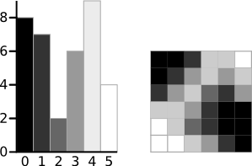
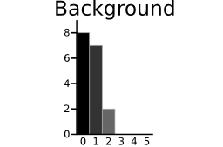
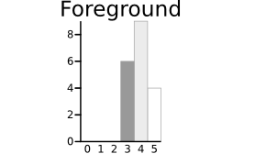
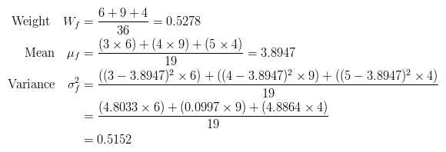
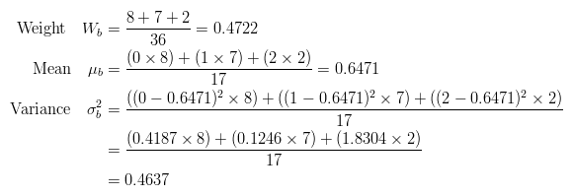
Otsu Thresholding
http://www.labbookpages.co.uk/software/imgProc/otsuThreshold.html

Slide 47
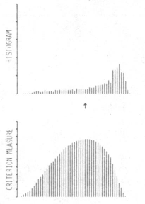
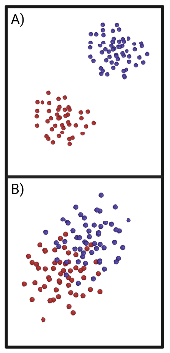

Discriminant Criterion Measure
Criterion measure
$η\left(T\right)=σ_{B}^{2}\left(T\right)/$ $σ_{T}^{2}$
$σ_{B}^{2}$= Between-class variance
$σ_{T}^{2}$ = Total variance
$0≤η^{∗}≤1$
Otsu, N. "A threshold selection method from gray-level histograms." IEEE Transactions on Systems, Man, and Cybernetics 9:1 (1979), pp 62-66.

Slide 48

Holes

Slide 49

Histogram stretching
stretching range of intensity values to achieve a higher contrast -> linear scaling
Pout = (Pin – c )($\frac{b−a}{d−c}$ ) + a
https://homepages.inf.ed.ac.uk/rbf/HIPR2/stretch.htm

Slide 50

Example Histogram stretching
https://i.stack.imgur.com/9gIw6.png

Slide 51


Two-level Otsu Thresholding
Two-level Otsu Thresholding
$σ_{B}^{2}=ω_{1}\left(μ_{1}−μ_{T}\right)2−$ $ω_{2}\left(μ_{2}−μ_{T}\right)2−$ $ω_{3}\left(μ_{3}−μ_{T}\right)2$
$ω_{1,2,3}$ = Probabilities of class occurrence
$μ_{1,2,3}$ = Class mean levels
$μ_{T}$ = Total mean level
Otsu, N. "A threshold selection method from gray-level histograms." IEEE Transactions on Systems, Man, and Cybernetics 9:1 (1979), pp 62-66.

Slide 52
Application of Filter
Choose Filtermask
Convolution
Flipping filter
Multiplication of filter values with image intensity values
Summation of the multiplication results

Slide 53
Cell counting
Why?
Monitor health of the cells
Proliferation rate
How?
Edge detection

Slide 54
Other threshold methods | Other segmentation methods
Kittler´s thresholding | K-means
Kapur´s thresholding | Watershed
Tsai´s thresholding | Graph cuts

Slide 55
„Final perfect recipe“
Diskussion beste ergebnis variante aufschreiben
Gloabl otsu and histogram stretching: 0.89

Slide 56
The perfect recipe
Diskussion beste ergebnis variante aufschreiben
Local adaptive thresholding average and gaussian filter and histogram stretching: 0.83

Slide 57
The perfect recipe
Diskussion beste ergebnis variante aufschreiben
Two level Otsu and histogram stretching: 0.89

